Slide 1
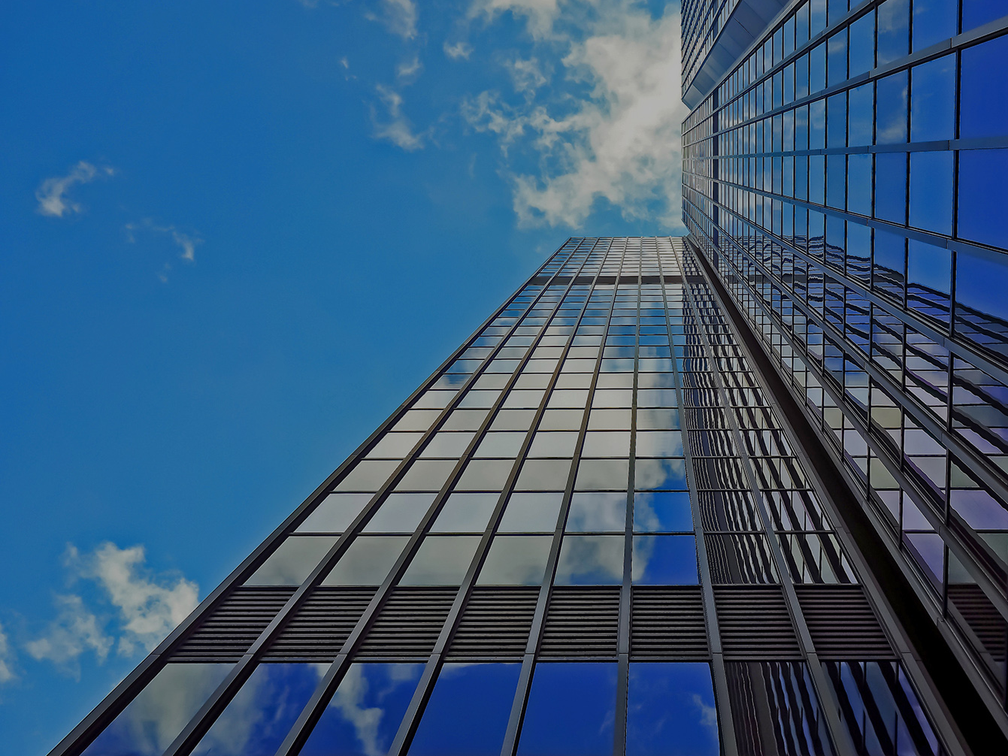
Detecting Building Defects Using VGG16 With IBM Cloud
Internship Project

Slide 2
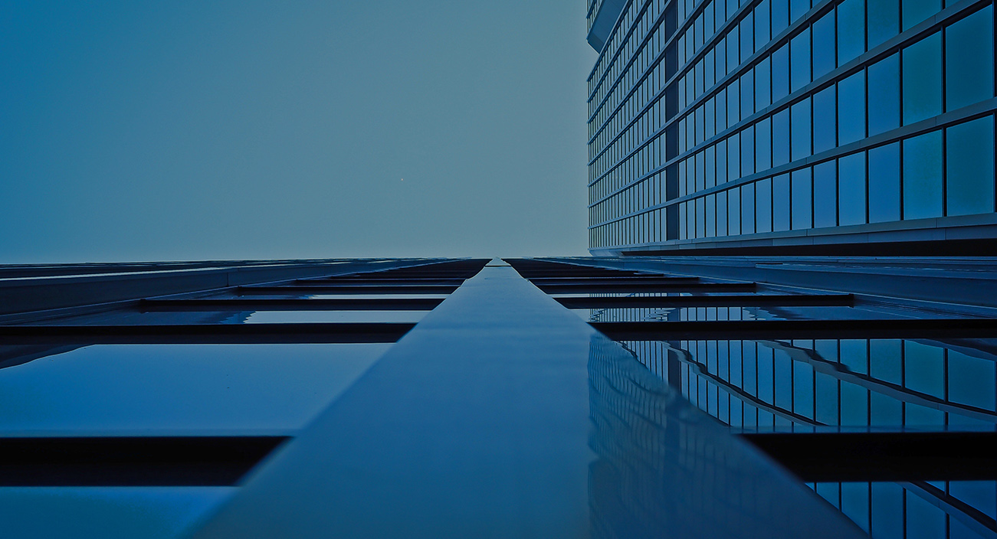
TEAM MEMBERS
18481A1242 - NARESH
18481A1226 - LOKESH
18481A1203 - PRABHU KIRAN
18481A1241 - NAGA LAKSHMI

Slide 3
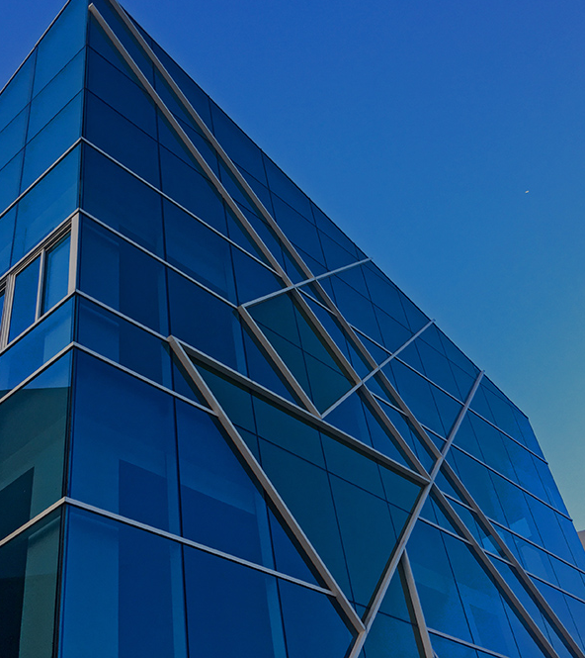
OVERVIEW
Introduction
Technical architecture
Project objective
Project flow
Image preprocessing
Model building
Application building

Slide 4
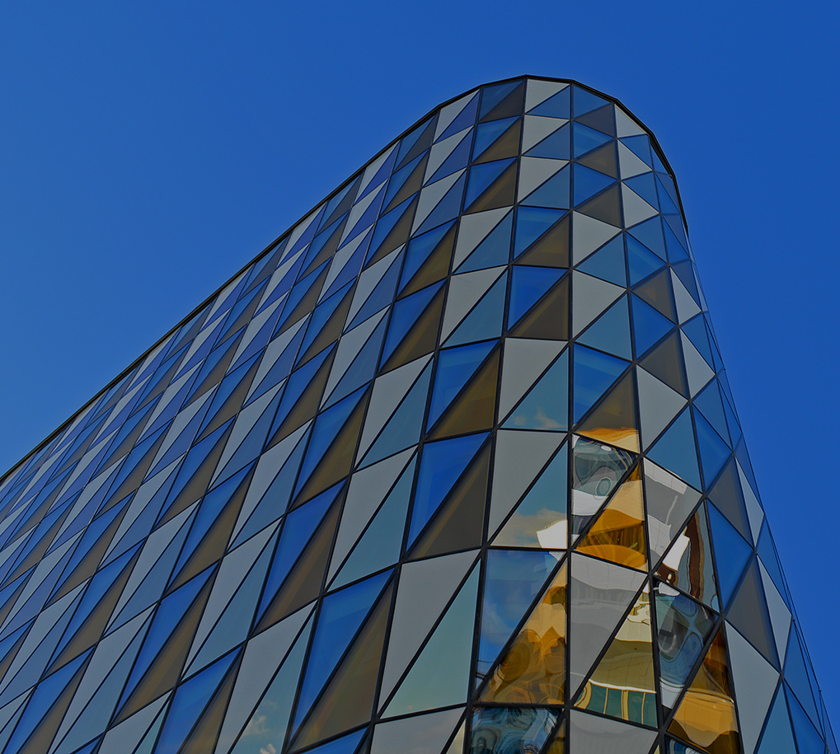
INTRODUCTION
Detection of defects including cracks and flakes on the wall surfaces in high-rise buildings is a crucial task of buildings maintenance. If left undetected and untreated, these defects can signi? cantly a?ect the structural integrity and the aesthetic aspect of buildings, Time and cost-e?ective methods of building condition survey are of practicing need for the building owners and maintenance agencies to replace the time- and labor-consuming approach of the manual survey.

Slide 5
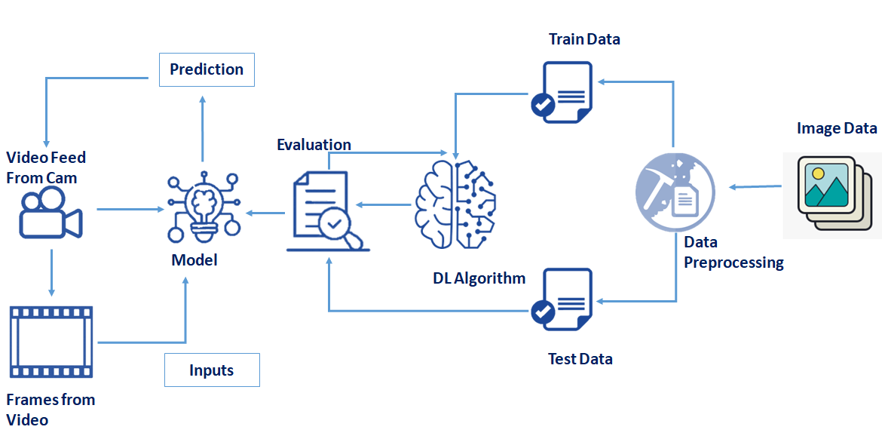
TECHNICAL ARCHITECTURE

Slide 6
PROJECT OBJECTIVES
By the end of this project you will:
know fundamental concepts and techniques of the Artificial Neural Network and Convolution Neural Networks
Gain a broad understanding of image data.
Work with Sequential type of modeling
Work with Keras capabilities
Work with image processing techniques
know how to build a web application using the Flask framework.

Slide 7
PROJECT FLOW
The user interacts with the UI (User Interface) to open the integrated webcam.
The video frames are captured and analyzed by the model which is integrated with the flask application.
Once the model analyses the video frames, the prediction is showcased on the UI and OpenCV window

Slide 8
IMAGE PREPROCESSING
Image Pre-processing includes the following main tasks
Import Image Data Generator Library.
Configure Image Data Generator Class.
Applying Image Data Generator functionality to the trainset and test set.

Slide 9
Now it's time to build our model. Let us use the pre-trained model which is VGG-16, one of the convolution neural net (CNN ) architecture which is considered a very good model for Image classification.
MODEL BUILDING

Slide 10
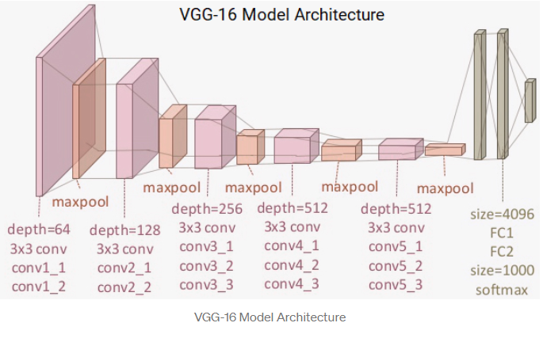
VGG16 (Pre-trained CNN model)

Slide 11
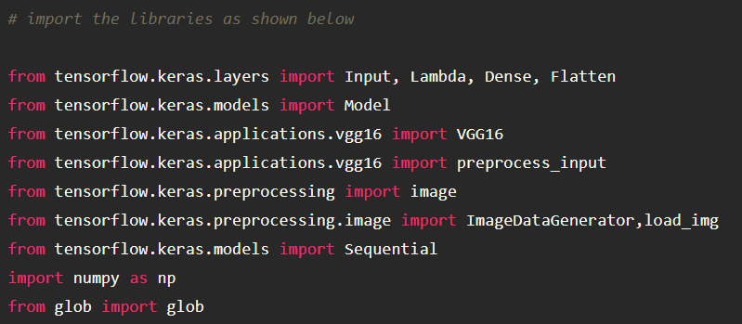
Importing The Model Building Libraries
Importing libraries is a very crucial step in our deep learning model building process. We have to define how our model will look and that requires.

Slide 12
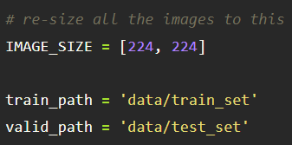
Resizing the images
If you use a pre-trained model you have to resize and normalize the input to the same format the network was originally trained on. 244x244 is a very common choice, but you need to check with the pre-trained model that you have.

Slide 13
Pre-Trained CNN Model As A Feature Extractor
For one of the models, we will use it as a simple feature extractor by freezing all the five convolution blocks to make sure their weights don’t get updated after each epoch as we train our own model.
Here, we have considered images of dimension (224,224,3).
Also, we have assigned include_top = False because we are using the convolution layer for features extraction and wants to train a fully connected layer for our images classification(since it is not the part of Imagenet dataset)
Flatten layer flattens the input. Does not affect the batch size.

Slide 14
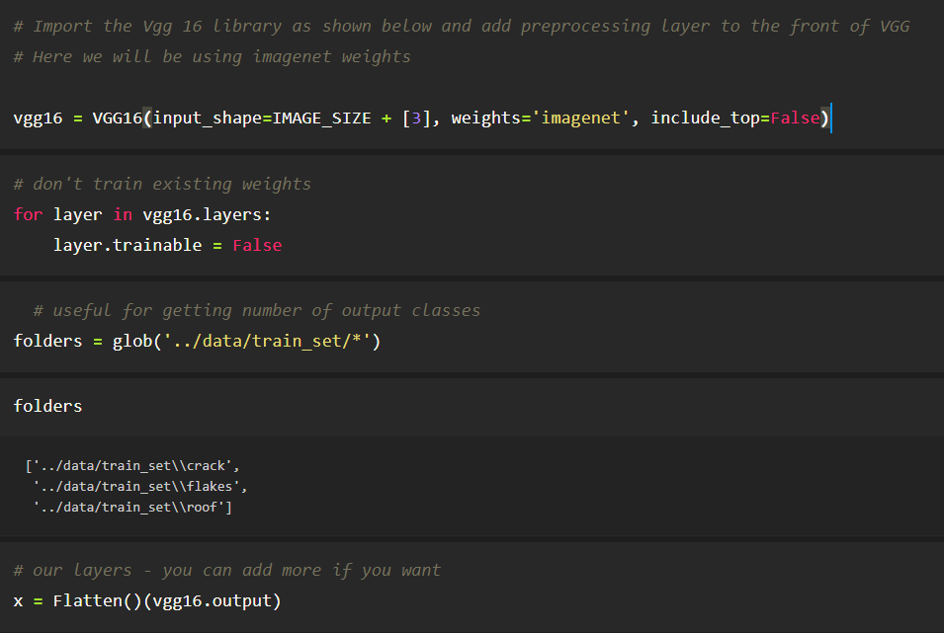

Slide 15
APPLICATION BUILDING
Now that we have trained our model, let us build our flask application which will be running in our local browser with a user interface. Copy the model saved which is present in the model building folder and paste it into the flask folder.

Slide 16
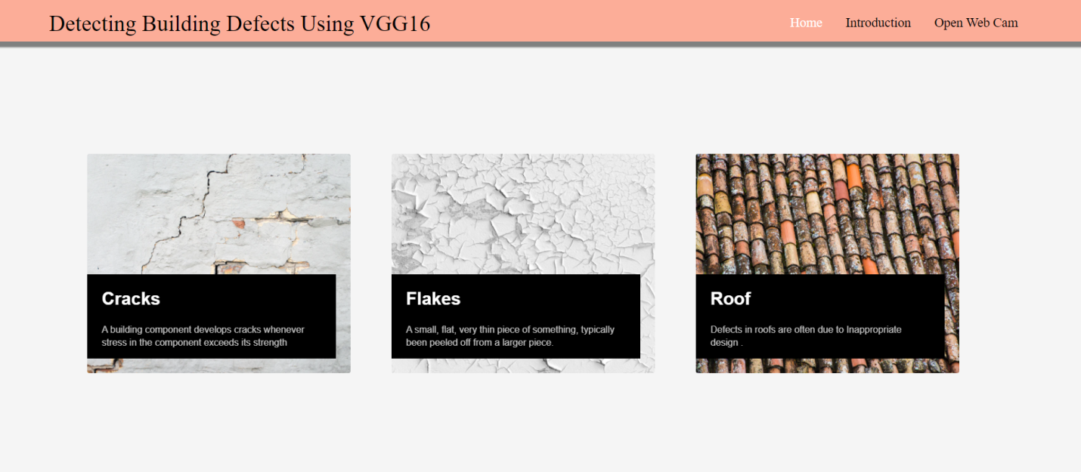
CREATE HTML PAGES
We use HTML to create the front end part of the web page.
Here, we have created 3 HTML pages- home.html, intro.html, and upload.html
home.html displays the home page.
Intro.html displays an introduction about the project
upload.html gives the emergency alert
We also use JavaScript-main.js and CSS-main.css to enhance our functionality and view of HTML pages

Slide 17
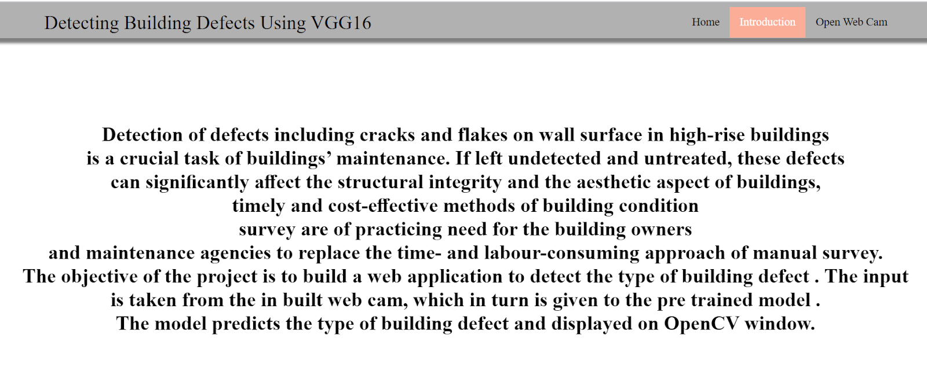
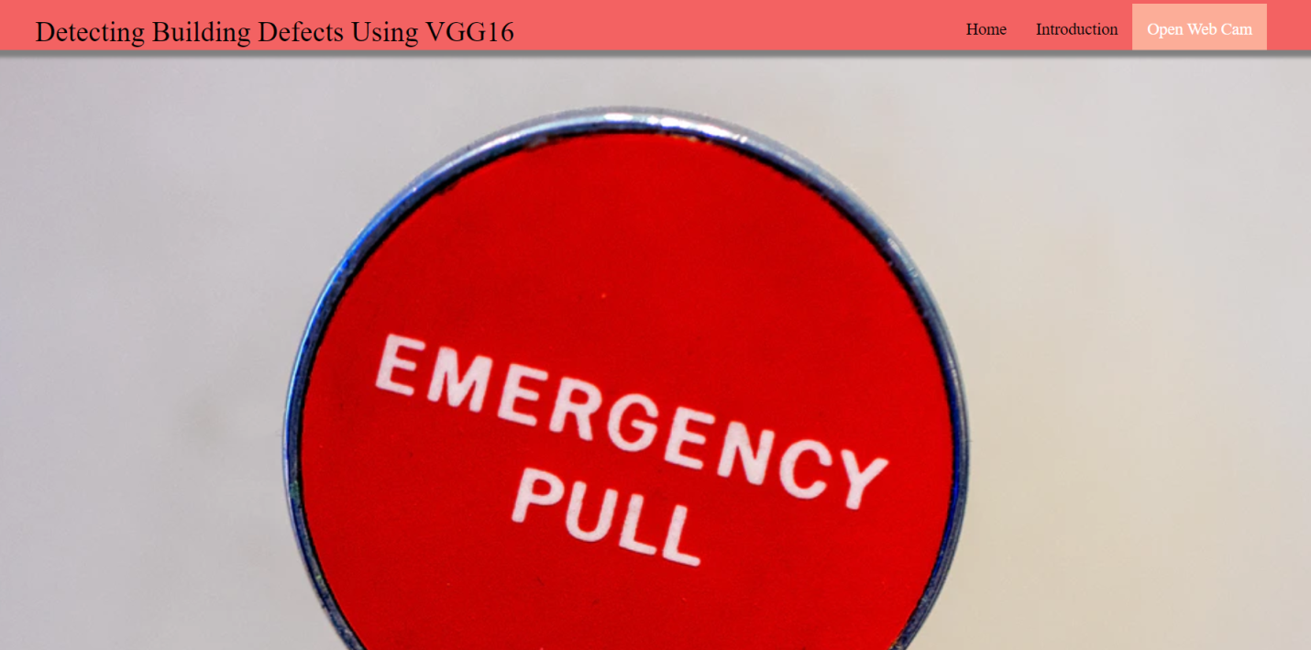

Slide 18
BUILD PYTHON CODE
Let us build flask file’app.py’ which is a web framework written in python for server-side scripting. Let’s see step by step procedure for building the backend application. Terms that you should know
app starts running when “__name__” constructor is called in main.
render template is used to return html file.
“GET” method is used to take input from the user.
“POST” method is used to display the output to the user.

Slide 19
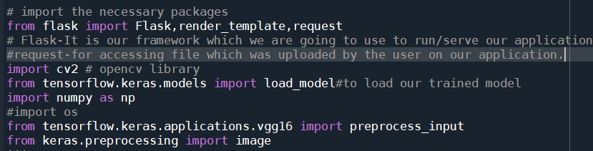
Steps to create Python code
Task 1: Importing Libraries
The first step is usually importing the libraries that will be needed in the program.
Importing the flask module in the project is mandatory. An object of the Flask class is our WSGI application. Flask constructor takes the name of the current module (__name__) as argument Pickle library to load the model file.

Slide 20
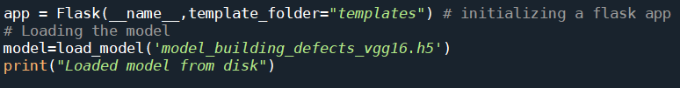
Task 2: Creating our flask application and loading our model by using load_model method

Slide 21
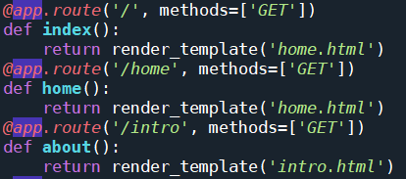
Task 3: Routing to the html Page
@app.route(“/”) is the default route. i.e. when the flask app runs on localhost, this route will be called first and the respective function is performed to render the template “home.html”.
@app.route(“/home”) is triggered when the “Home” button is clicked and the respective function is performed to render the template “home.html”.
@app.route(“/intro”) is triggered when the “Introduction” button is clicked and the respective function is performed to render the template “intro.html”.
@app.route(“/upload”) is triggered when the “Open Web Cam” button is clicked and the respective function is performed to open the web camera

Slide 22
Tasks :
The tasks involved are
Grab the frames from the webcam.
Loop over the frames from the video stream
Convert the image from BGR to RGB
Predicting our results
Displaying the result

Slide 23
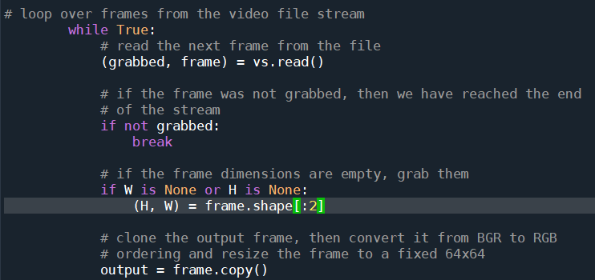
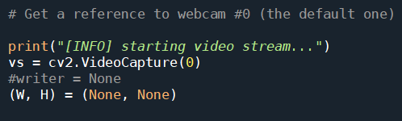
1.Grab the frames from the webcam
2. Loop over the frames from the video stream
To recognize the type of building defect we have to capture the video stream. There are two ways we can capture the input video
1.using in-built webcam
2. using video file residing on the disk
Let us grab the video frames from the video by looping over the frames and check if the frame was not grabbed, then we have reached the end of the stream. clone the output frame for showcasing the output

Slide 24
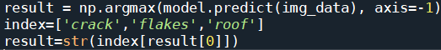
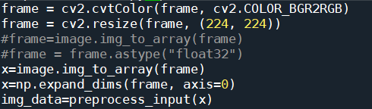
4.Predicting the results
3.Convert the image from BGR to RGB
The frame we have captured is a 3-channel RGB-colored image.
convert it from BGR to RGB, resize the frame to a fixed 224x224 and expand the dimensions and pre-process the input (in such a way that VGG16 accepts) to give it to the model for prediction.
We then proceed to detect all types of building defects in the input image using model.predict function and the result is stored in the result variable.

Slide 25
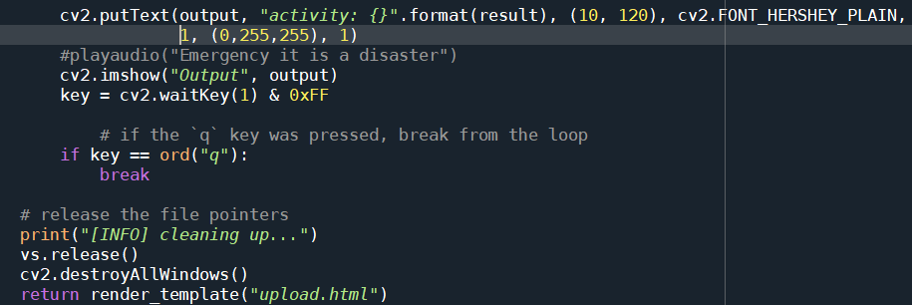
5.Displaying the result
After we recognize the type of building defect, we have to display the same on the live video stream for visualization.
The cv2.imshow() function always takes two more functions to load and close the image. These two functions are cv2.waitKey() and cv2.destroyAllWindows(). Inside the cv2.waitKey() function, you can provide any value to close the image and continue with further lines of code.

Slide 26
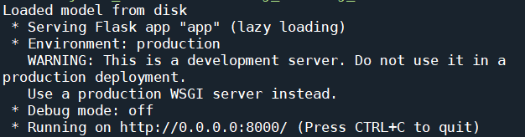
RUN THE APPLICATION
Open the anaconda prompt from the start menu.
Navigate to the folder where your app.py resides.
Now type “python app.py” command.
It will show the local host where your app is running on http://127.0.0.1.8000/
Copy that localhost URL and open that URL in the browser. It does navigate me to where you can view your web page.
Enter the values, click on the predict button and see the result/prediction on the web page.
Then it will run on localhost:8000

Slide 27
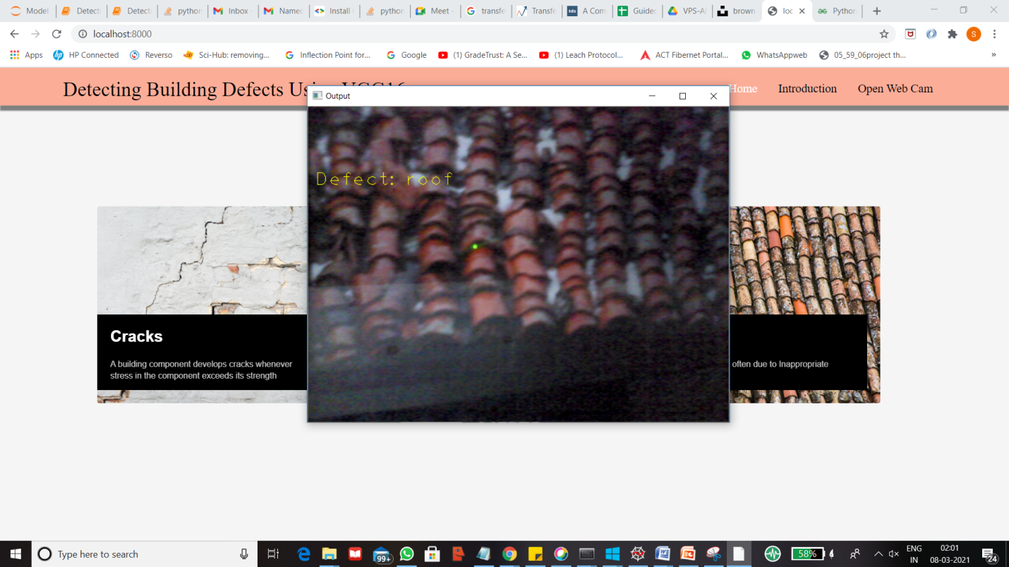
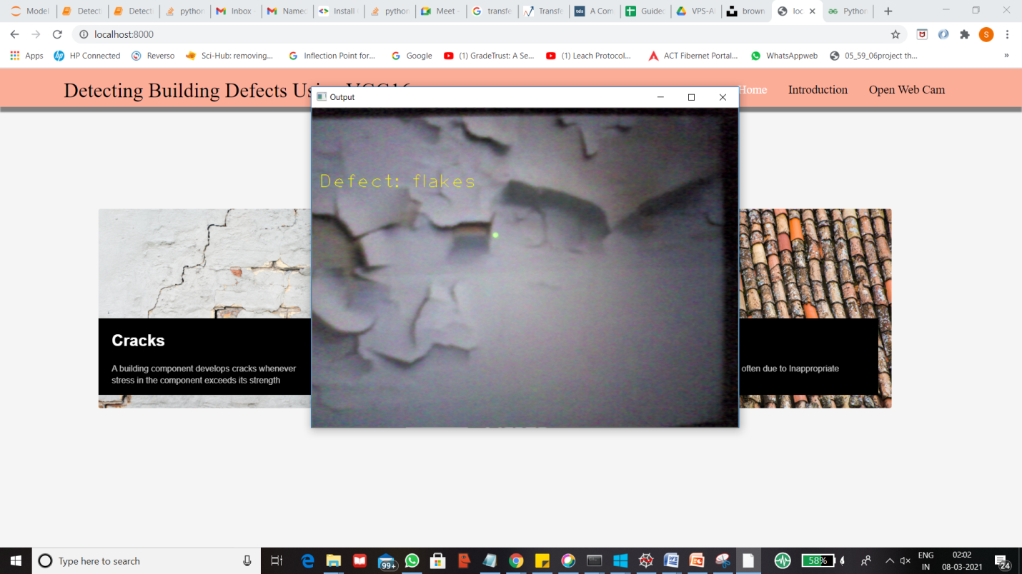
Prediction page

Slide 28
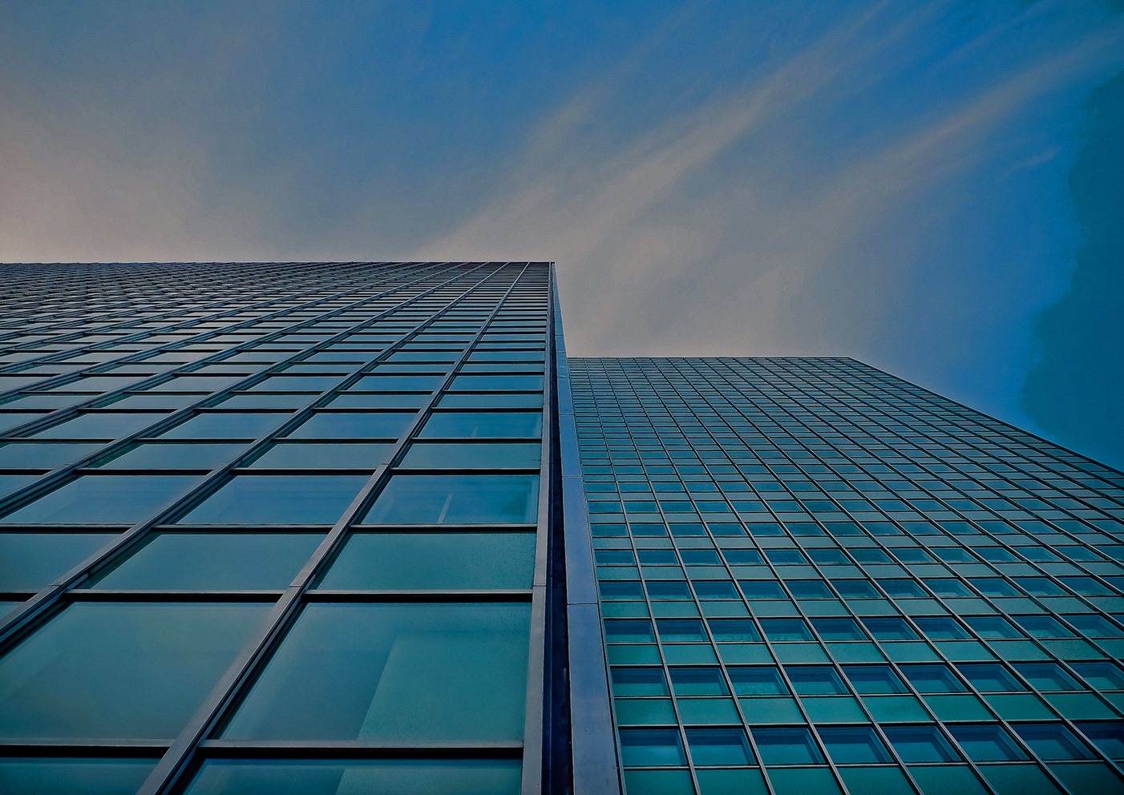
THANK YOU!

